Slide 1
Edinburgh Business School MBA
AUC Academic Partner
Strategic Planning
Module 5 – Part 1
The Company and the Market
Instructor: Moataz Darwish, MBA

Slide 2
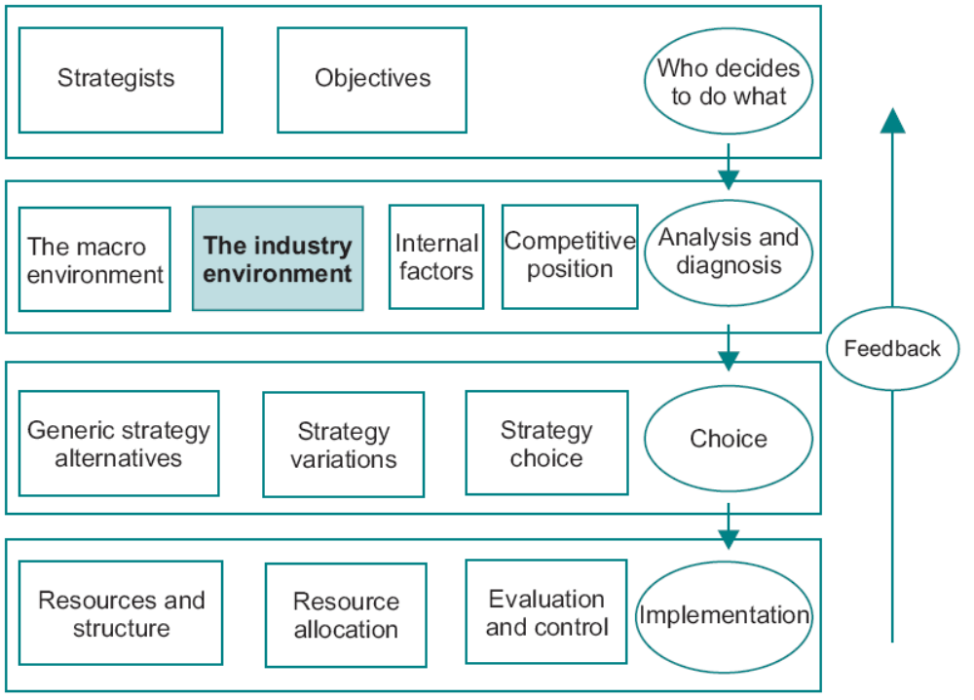
The Model
EBS MBA / AUC

Slide 3
Contents
The Market
The Demand Curve
Competitive Reaction
Segmentation
Product Quality
Product Life Cycles
Portfolio Models
Supply
Markets and Prices
Market Structures
The Role of Government
The Structural Analysis of Industries
Strategic Groups
First Mover Advantage
An Overview of Macro and Micro Models 5/61
Environmental Threat and Opportunity Profile: Part 2
EBS MBA / AUC

Slide 4
The Market
The market mechanism is the principal method by which resources are allocated in industrialized economies.
An understanding of how markets operate provides managers with insights into the behavior of
  Customers
  Competitors
  Role of Government.
EBS MBA / AUC

Slide 5
The Market
Corporate Level
  Are we in the right markets?
  What resources should be allocated to various markets?
Business Unit Level
  What price should we be charging for our product?’
  How much should we be spending on marketing?’
Functional Level
EBS MBA / AUC

Slide 6
Contents
The Market
The Demand Curve
Competitive Reaction
Segmentation
Product Quality
Product Life Cycles
Portfolio Models
Supply
Markets and Prices
Market Structures
The Role of Government
The Structural Analysis of Industries
Strategic Groups
First Mover Advantage
An Overview of Macro and Micro Models 5/61
Environmental Threat and Opportunity Profile: Part 2
EBS MBA / AUC

Slide 7
The First Step
Develop the role of Demand and Supply analysis
EBS MBA / AUC

Slide 8
The Demand Curve
Demand Curve:
  Relation between the price of a good and the amount which would be bought at each price.
  Elastic: If quantity changes by a large relative amount when price is changed.
  Inelastic: if quantity is not affected much by changes in price.
  what the elasticity tells is what happens to total revenue when price is changed.
  The demand curve has important implications for pricing strategy.
EBS MBA / AUC

Slide 9
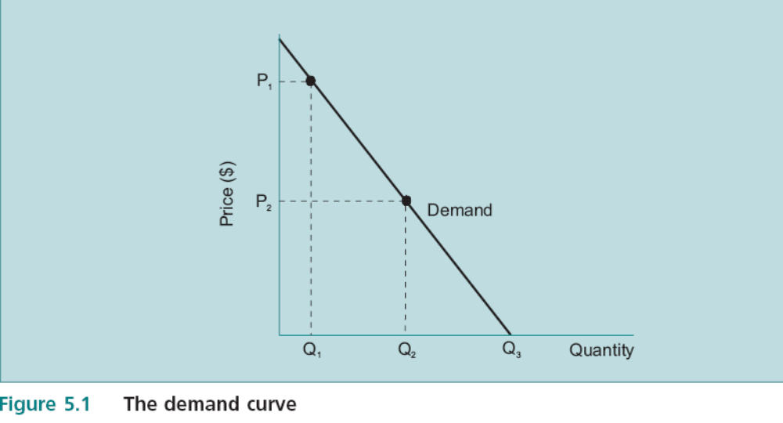
The Demand Curve
EBS MBA / AUC

Slide 10
The Demand Curve
Ceteris Paribus Concept:
  The approach of allowing only one variable to change while holding other things constant.
  Powerful method of focusing on individual variables and how they affect the company.
  Degree of abstraction to help think in terms of ‘what if’;
EBS MBA / AUC

Slide 11
The Demand Curve
Demand Factors
Demand Curve and Revenue
Demand Curve and Market Share
Demand Curve and Marketing Expenditure
Estimating the Demand Curve
EBS MBA / AUC

Slide 12
The Demand Curve
1- Demand Factors
Market Size
Company Mkt Share
  Product life cycle
  Business cycle
  Exogenous shocks
  GNP elasticity
  Exchange rates
  Price
  Marketing
Level of control
EBS MBA / AUC

Slide 13
The Demand Curve
The shipping industry ex.
  Change in exchange rates.
  Effect on trade flows from one leg to the other.
  Needs marketing and price actions to respond.
EBS MBA / AUC

Slide 14
The Demand Curve
2-Demand Curve and Revenue
How responsive the quantity sold will be to the change in price.
Help predict the effect of a change in price on the revenue from selling the product.
  Revenue = P1 × Q1 is greater or less than P2 × Q2
Every straight line demand curve has a point at which revenue is maximized.
Implication: The manager can now think in terms of whether revenues have been maximized in current situation, and what might be done to maximize revenues in the future.
EBS MBA / AUC

Slide 15
The Demand Curve
3-Demand Curve and Market Share
The emphasis in marketing strategy tends to be on market share.
Direct relationship between demand curve & market share
  derived from similar information.
EBS MBA / AUC

Slide 16
The Demand Curve
3-Demand Curve and Market Share
The basic model of income:
  Revenue = Total market × Market share × Price
The demand curve expresses this as:
  Revenue = Total units sold × Price
Implication: forces managers to be explicit about the expected impact of price changes on the quantity bought and eventually market share.
EBS MBA / AUC

Slide 17
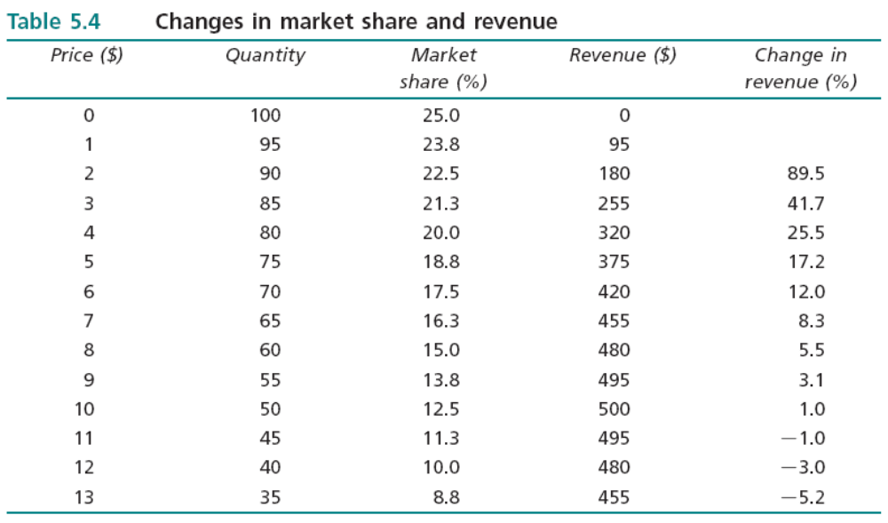
The Demand Curve
3-Demand Curve and Market Share
  Reduction in market share can be associated with an increase in revenue.
  If objective is to maximize revenue→ optimum price is $10 at 12.5% Mkt share.
  One of the strategic goals often pursued by companies is to increase market share→leads to a disagreement.
Ceteris Paribus
EBS MBA / AUC

Slide 18
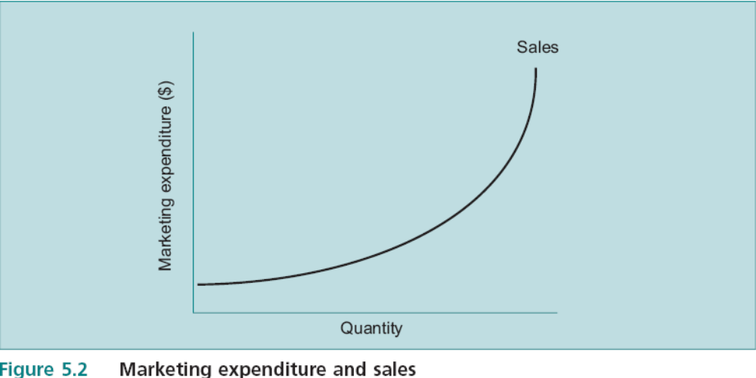
The Demand Curve
4-Demand Curve and Marketing expenditure
It becomes increasingly difficult to achieve additional sales through increases in marketing expenditure alone
Increase in expenditure may have no impact at the margin
EBS MBA / AUC

Slide 19
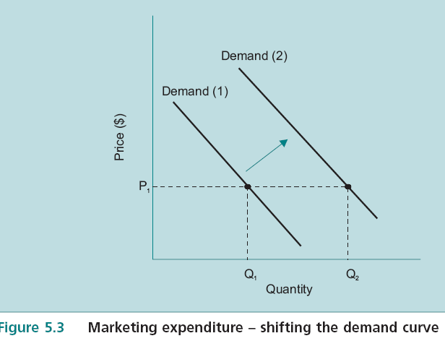
The Demand Curve
4-Demand Curve and Marketing expenditure
Marketing Campaign would cause more of the product will be sold at each price than before - shift the demand curve to the right (Figure 5.3)
  It is necessary to change people’s preferences using lots of resources (time & money) in order to:
    Persuade people to buy more of product and less of something else or
    Save less
Pepsi spent $500mln in 1996 simply on changing the can color
EBS MBA / AUC

Slide 20
The Demand Curve
4-Demand Curve and Marketing expenditure
Its is a powerful marketing strategy tool to combine a shift of the demand curve with a movement along the demand curve (price reduction).
  Distinction between them is very important:
    Shift is due to lots of factors (mostly outside Co control, ex: reduction of the price of a substitute product, or increase in price of a complement.
One question which should be considered is the likely impact of extraneous effects on the demand curve for the company’s product→ helps in formulating a strategic response
EBS MBA / AUC

Slide 21
The Demand Curve
4-Demand Curve and Marketing expenditure
Important strategic reasons for distinguishing between a shift along a demand curve and a shift of the demand curve:
  It is necessary to focus on the potential impact of a price change on its own.
  A shift of the demand curve can be caused by factors outside the control of the company.
  It is difficult to change the position of the demand curve.
EBS MBA / AUC

Slide 22
The Demand Curve
5-Estimating the demand curve
It may be possible to derive reasonable estimates of the industry demand curve.
considerable amount of relevant information available both of a statistical and of a subjective nature, particularly at the industry level.
the manager should maintain a healthy cynicism of statistical approaches to the demand curve facing the individual company.
EBS MBA / AUC

Slide 23
Contents
The Market
The Demand Curve
Competitive Reaction
Segmentation
Product Quality
Product Life Cycles
Portfolio Models
Supply
Markets and Prices
Market Structures
The Role of Government
The Structural Analysis of Industries
Strategic Groups
First Mover Advantage
An Overview of Macro and Micro Models 5/61
Environmental Threat and Opportunity Profile: Part 2
EBS MBA / AUC

Slide 24
Competitive Reaction
The great imponderable in analyzing markets is to:
Predict how competitors are likely to
react to strategic moves
The attempt to predict competitive reaction presents many dilemmas.
the important point is to be aware that such dilemmas exist, rather than attempt to prescribe complex gaming rules.
EBS MBA / AUC

Slide 25
Competitive Reaction
Game Theory
game theory is a complex subject; while it is highly mathematical it provides important insights into behaviour.
A well known example is the ‘zero sum game’
  Any gain made by one party is at the expense of the other.
  Ex. cigarette market where sales is static/declining → Marketing affects market share rather than whole market:
    Tacit agreements on prices VS Price wars
Attempting to frame a game strategy companies are faced with potential costs and benefits, all associated with a high degree of uncertainty.
use competitors’ information of all kinds
A profile of competitors’ strengths and weaknesses can help indicate the likely response to different courses of action.
company must be prepared for a variety of responses to any competitive action.
But even with full information on competitors it can be impossible to arrive at an optimum strategy as illustrated in the Prisoner’s dilemma
EBS MBA / AUC

Slide 26
Competitive Reaction
Game Theory
Prisoner’s dilemma - police are trying to make two suspects confess to a major crime:
  1- if he confesses:
    A: he will go free if the other remains silent
    B: he will go to prison for 7 years if the other also confesses
  2- if he remains silent:
    A: he will be sent to prison for 1 year on a minor charge if the other remains silent
    B: he will go to prison for 10 years if the other confesses.
EBS MBA / AUC

Slide 27
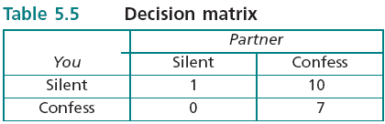
Competitive Reaction
Game Theory
Prisoner’s dilemma:
  what is your best course of action?
  number of years you will spend in prison for each possible action depending on what your partner in crime does.
EBS MBA / AUC

Slide 28
Competitive Reaction
Game Theory
Prisoner’s dilemma:
  Assume that you and your partner commit the same crime and end up in exactly the same position once more!
  But this is a true dilemma: once you have reached the agreement then you have an incentive to confess, because you will go free.
  But the same logic applies to your partner!
  so once again you will both end up confessing and going back to prison for 7 years.
  The point of the dilemma is that:
    not only does the situation lead to an outcome which is not in the best interests of either party, but
    experience does not lead to a different outcome.
EBS MBA / AUC

Slide 29
Competitive Reaction
Game Theory
Prisoner’s dilemma - important lessons for business
  The only way out of this dilemma is to introduce another variable which gives an incentive to stick to the agreement. This variable is the knowledge that the situation will be repeated an unknown number of times.
  Why an unknown number of times?
  Because after each 1 year sentence it is worthwhile to enter into the agreement, but if it is known that this is the last time then both of you will have an incentive to break it.
  A great deal of stress is laid on trust and commitment in cooperative business ventures.
the fundamental point of the original dilemma is unaltered: unless there is trust and commitment to a course of action there is always an incentive for one party to break ranks.
EBS MBA / AUC

Slide 30
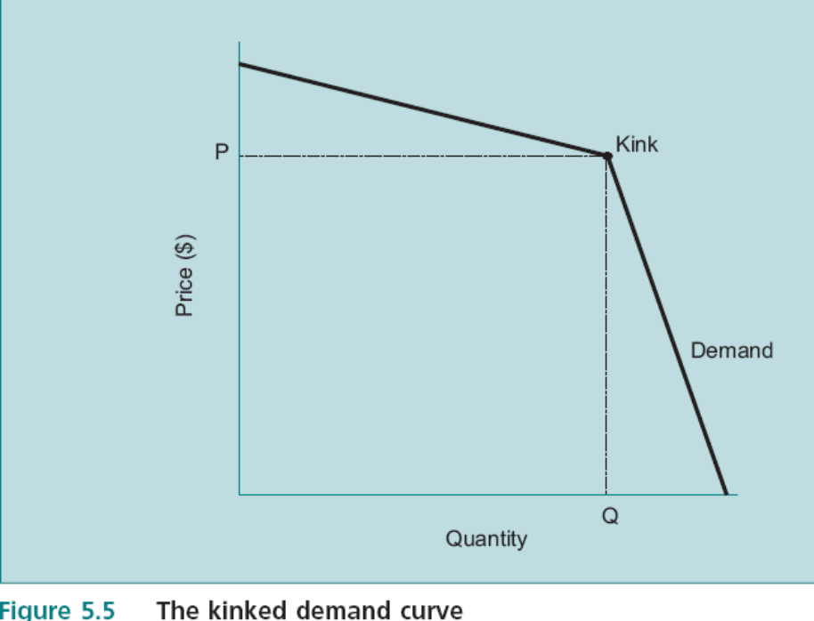
Competitive Reaction
The Kinked Demand Curve
relatively few competitors
little operational meaning because its shape and position depends on competitive reaction, which in turn cannot be predicted.
revenue is maximized at the current price
Implications on Revenue: tradeoff between giving up revenues now in order to increase market share, and the expectation of higher
revenues in the future when price can be returned to its original level at the
higher market share.
Implications on Pricing: necessary to make a significant price change and stick with it. Otherwise the price change will have virtually no effect because of competitor reaction. But the danger is that a competitive pricing move may lead to a price war the outcome of which is unpredictable.
EBS MBA / AUC

Slide 31
Competitive Reaction
Competitive Pricing
Three main forms of competitive pricing
  Price leadership
  Limit pricing
  Predatory pricing
    the dominant firm in the industry announces its price changes before all other firms, which then match the leader’s price.
    erect an entry barrier by charging a low price in order to deter entry;
    objective of driving new entrants or existing firms out of business.
    requires cash reserves or low costs
Rarely found in practice. competition cannot be avoided.
EBS MBA / AUC

Slide 32
Contents
The Market
The Demand Curve
Competitive Reaction
Segmentation
Product Quality
Product Life Cycles
Portfolio Models
Supply
Markets and Prices
Market Structures
The Role of Government
The Structural Analysis of Industries
Strategic Groups
First Mover Advantage
An Overview of Macro and Micro Models 5/61
Environmental Threat and Opportunity Profile: Part 2
EBS MBA / AUC

Slide 33
Segmentation
It is often misleading to think in terms of a product which is sold to a homogeneous group of consumers.
Market segment is:
  a group of consumers within a broader market who possess a common set of characteristics,
  and consumers in a segment respond to market mix variables in broadly the same way.
EBS MBA / AUC

Slide 34
Segmentation
Market demand curve is the summation of the demand curves for market segments;
The objective in segmentation is to:
  Identify different groups according to their characteristics,
  Estimate how they are likely to react to different selling approaches directed at them,
  Allocate marketing effort accordingly.
Some characteristics for market segmentation are:
  income,
  social class,
  geographical location,
  age,
  sex,
  family size,
  educational background, etc.
EBS MBA / AUC

Slide 35
Segmentation
Four main characteristics which a segment needs to have:
  Identifiable: sufficient common features.
  Demand related: at least one characteristic which translates into demand terms, ex. willingness to pay more for a high quality product.
  Adequate size: to ensure attractive return on the investment.
  Attainable: be reachable by available marketing and advertising approaches
EBS MBA / AUC

Slide 36
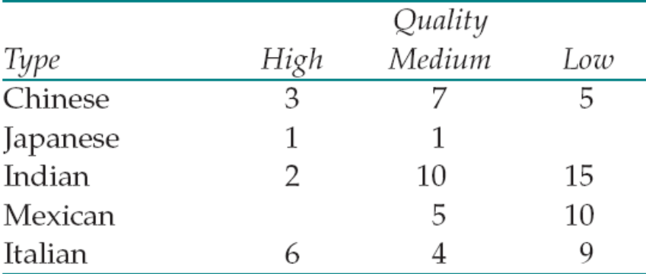
Segmentation
Key steps for carrying out a segmentation analysis:
  1- Identify the Most Important Segmentation Variables
    Product / segment / location or criteria
  2- Construct a Segmentation Matrix to identify segmentation gaps
    Any reasons for the gap?
  3- Analyze Segment Attractiveness (multiple strategic tools)
  4- Identify the Key Success Factors: (necessary, but not sufficient rule)
    activities which must be completed as a precondition for success (ex. Japanese cooks are very rare!).
EBS MBA / AUC

Slide 37
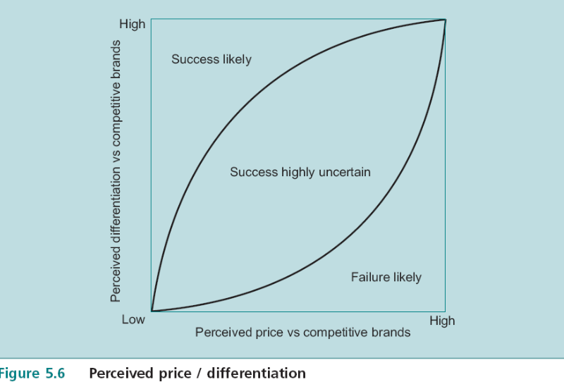
Segmentation
The Effect of Product Differentiation
  Extends the concept of segmentation to the determination of which bundle of characteristics should be incorporated in the version of the product targeted at each group.
  The two most important determinants of a product’s success are likely to be:
    the price of the product compared to similar products,
    and the degree to which consumers perceive the product as a different offering (perceived differentiation) – ex Aspirin
EBS MBA / AUC

Slide 38
Segmentation
Pricing in Segments
  What is the optimum price to charge in each segment?
  market conditions differ among segments.
  different prices can be charged.
  discriminating monopoly in economics.
  importance of market rather than cost conditions when setting prices.
  Economic (demand) , accounting (costing) and marketing (segmentation variables) approaches can be integrated.
  Segmentation is a potentially powerful tool for transforming a loss-making product into a profitable product without changing anything but the price charged to different groups of consumers.
EBS MBA / AUC

Slide 39
Contents
The Market
The Demand Curve
Competitive Reaction
Segmentation
Product Quality
Product Life Cycles
Portfolio Models
Supply
Markets and Prices
Market Structures
The Role of Government
The Structural Analysis of Industries
Strategic Groups
First Mover Advantage
An Overview of Macro and Micro Models 5/61
Environmental Threat and Opportunity Profile: Part 2
EBS MBA / AUC

Slide 40
Product Quality
Product differentiation through superior quality
Transcendent Quality
Product Based Quality
User Based Quality
Production Based Quality
Value Based Quality
  Dimensions of Quality
  Quality and Strategy
EBS MBA / AUC

Slide 41
Product Quality
Transcendent Quality
  Platonic definition
Product Based Quality
  The characteristics approach
  but product characteristics are not necessarily determinants of product quality;
  there can be very high costs associated with improving dimensions of quality.
User Based Quality
  functional, measurable characteristic.
Production Based Quality
  conformance with specifications.
Value Based Quality
  hybrid notion which combines the price, or production cost, with the quality
EBS MBA / AUC

Slide 42
Product Quality
Dimensions of Quality - multidimensional nature of quality
  Garvin
    performance
    features
    reliability
    conformance
    durability
    serviceability
    aesthetics
    overall perceived quality
EBS MBA / AUC

Slide 43
Product Quality
Quality and Strategy
  relationship between product characteristics and market performance;
  quality and advertising;
  quality is positively related to market share,
  quality and profitability (as measured by ROI) are correlated.
  While quality appears to be a potentially powerful strategy tool, it is difficult to be precise about exactly how it might contribute to company success.
  total quality management (TQM) / standards
EBS MBA / AUC

Slide 44
Contents
The Market
The Demand Curve
Competitive Reaction
Segmentation
Product Quality
Product Life Cycles
Portfolio Models
Supply
Markets and Prices
Market Structures
The Role of Government
The Structural Analysis of Industries
Strategic Groups
First Mover Advantage
An Overview of Macro and Micro Models 5/61
Environmental Threat and Opportunity Profile: Part 2
EBS MBA / AUC

Slide 45
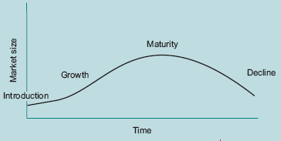
Product Life Cycles
The product life cycle is a powerful tool for systemising many of the changes in these factors by:
  providing an overview of the evolution of the market for a product
  thus enabling managers to interpret the current market situation and future prospects in a structured manner.
Since industries are composed of products the idea of the life cycle can be generalized to the industry level,
The stage in the product life cycle affects profitability, capacity utilization and competitive reaction.
EBS MBA / AUC

Slide 46
Product Life Cycles
The product life cycle model needs to be seen in the context of the business cycle.
There are various approaches to defining the product life cycle; some analysts use the
  pattern of company sales,
  others total market sales, and
  others profit generation.
Some product characteristics can help to generate a rough idea of what the life cycle might look like.
  Substitutes:
  Technology:
  Durability and replacement:
EBS MBA / AUC

